Slide 1

DANSK BRODAG 2013
"Kyssebroen"
Ny bro over Inderhavnen i København
Ian Firth
Flint & Neill
9 April 2013

Slide 2
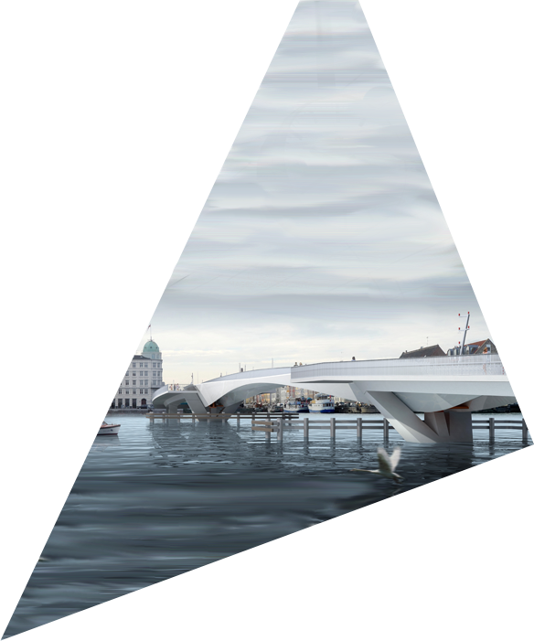
Introduction

Slide 3
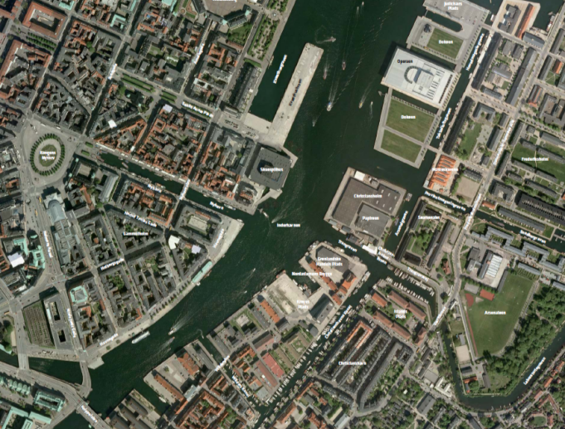
Bridge Location
Canal Bridges
Inner Harbour Bridge

Slide 4
Who's who
CLIENT
Københavns Kommune
(Teknik- og Miljøforvaltningen)
DESIGN TEAM
Flint & Neill Lead Designer
Studio Bednarski Architect
COWI Geotechnical, Environmental, Marine, Project Support
Hardesty & Hanover Mechanical & Electrical
Speirs & Major Lighting Design
CONTRACTORS
Pihl
Tadarsa (Spain) Steelwork
SH Group Mechanical works

Slide 5
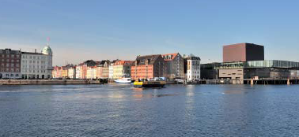
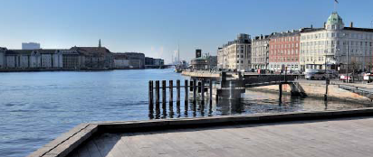
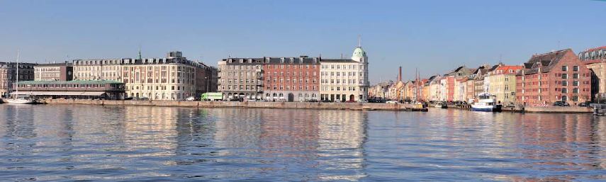
The Site

Slide 6
The Brief
7m wide (4m cycles, 3m pedestrians)
20m x 5.4m clear navigation envelope when bridge closed
45m wide navigation channel (infinite height) when open
Max 4% gradient (max 4.5% permitted on short ramps)
Stringent pedestrian dynamic response criteria
Service vehicle loads in addition to pedestrian loading
Ice and vessel impact loading on piers
Allowance for future sea level rise

Slide 7
Concept

Slide 8
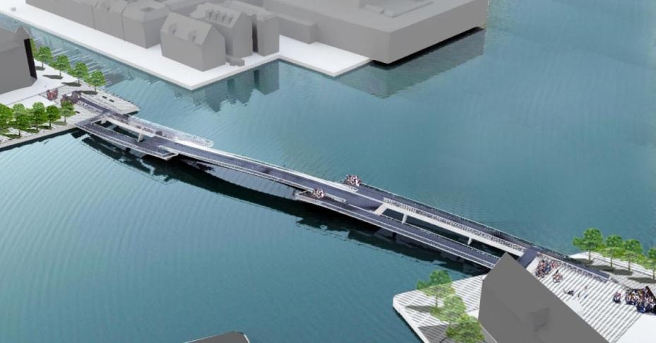
Bridge Closed

Slide 9
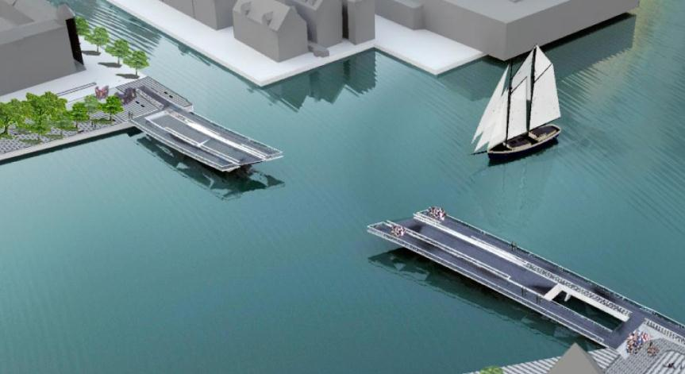
Bridge Open

Slide 10
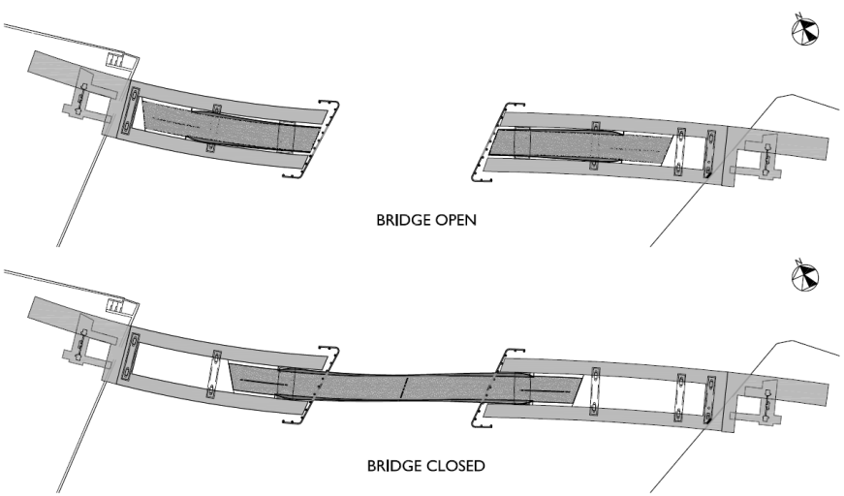
Plan, Bridge Open and Closed

Slide 11
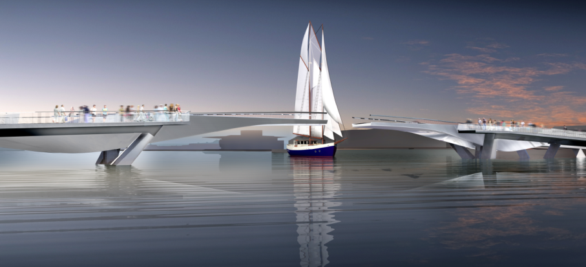
Bridge concept

Slide 12
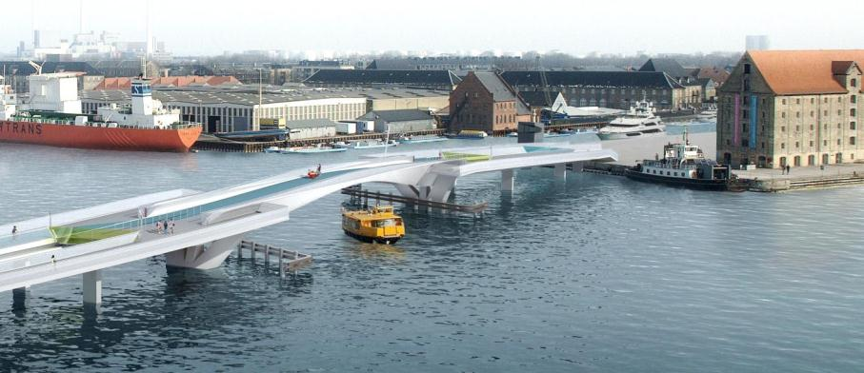
Bridge concept

Slide 13
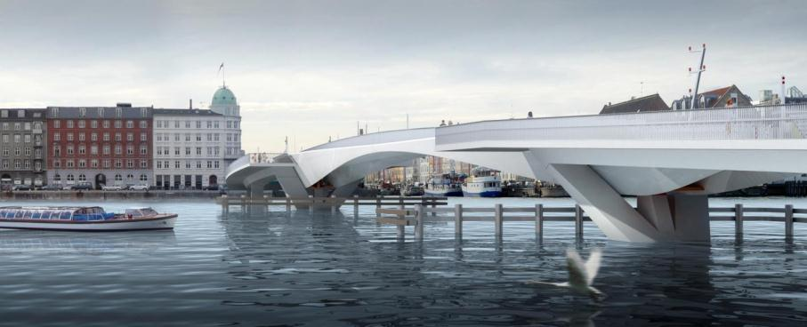
Bridge concept

Slide 14
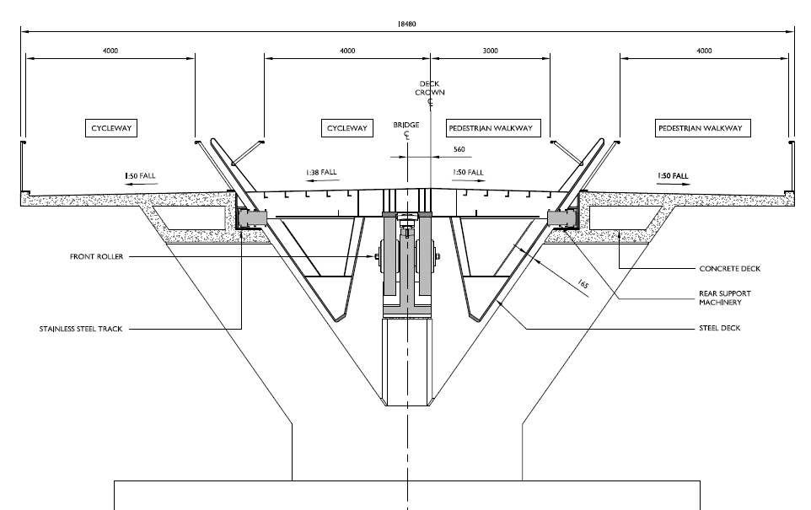
General Cross Section

Slide 15
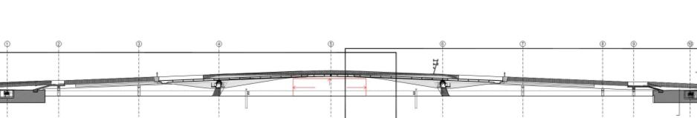
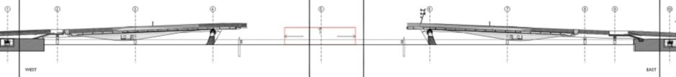
Long Section, Bridge Closed and Open

Slide 16
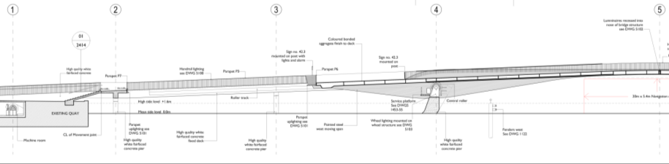
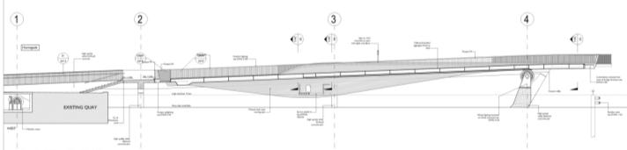
Long Section, Bridge Closed and Open
Rear Support Bogies
Nose pins
Front Roller Support
Rear Support Bogies
Front Roller Support

Slide 17
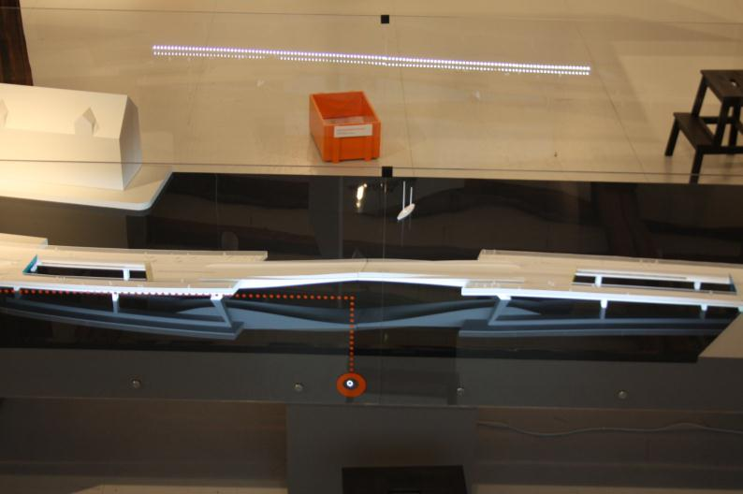
Model at Danish Architecture Centre

Slide 18
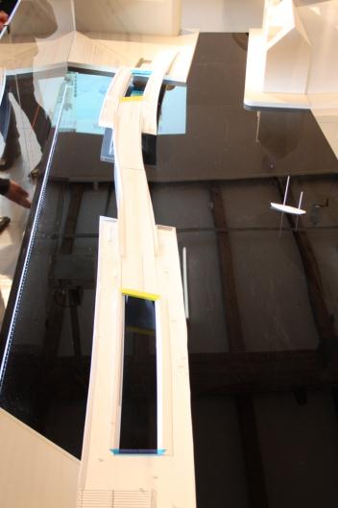
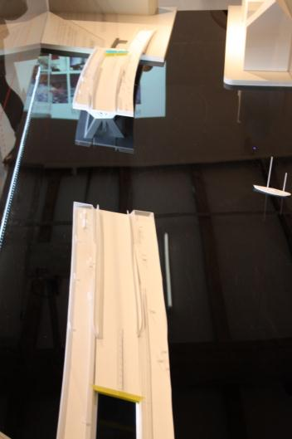
Model at Danish Architecture Centre

Slide 19
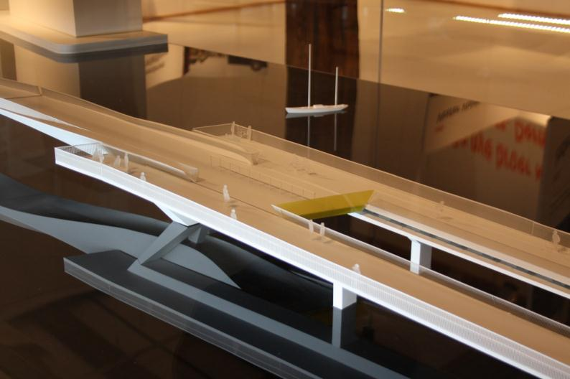
Model at Danish Architecture Centre

Slide 20
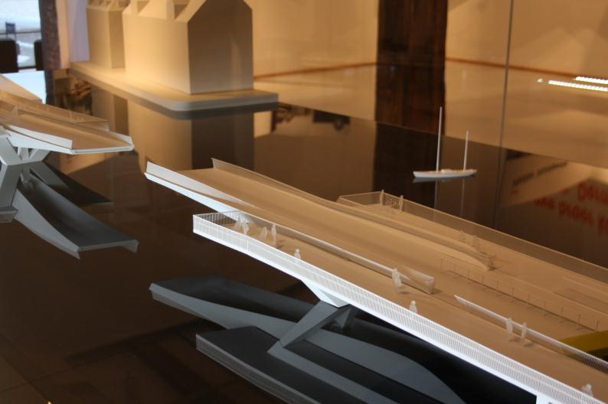
Model at Danish Architecture Centre

Slide 21
Operation

Slide 22
Model at DAC
model video

Slide 23
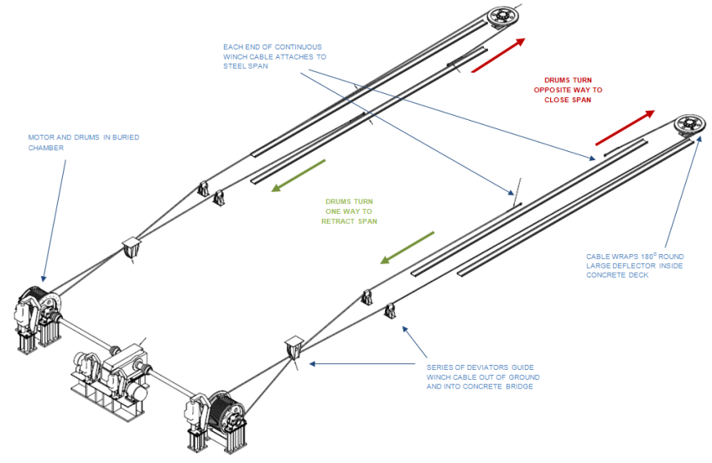
Operating System

Slide 24
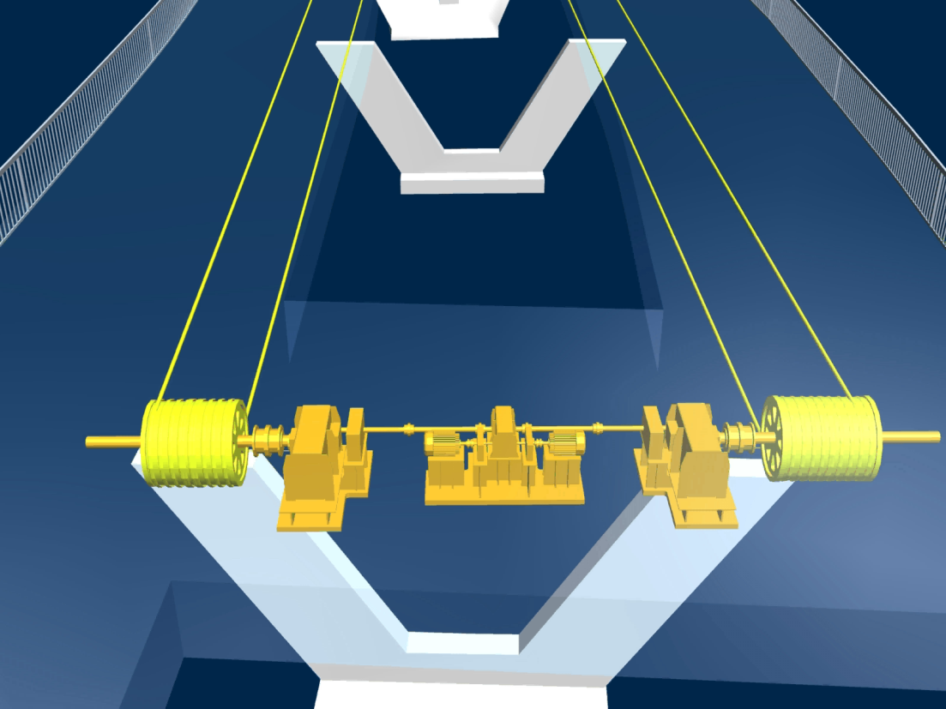
Bridge Operation (competition stage)

Slide 25
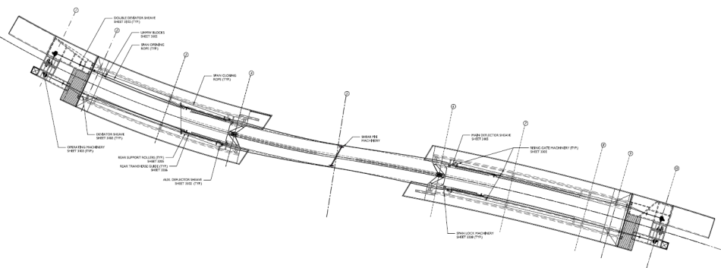
Principal Machinery Components
REAR SUPPORT BOGIES
FRONT ROLLER SUPPORT
RISING GATE
OPERATING MACHINERY
DEFLECTOR SHEAVES
NOSE PINS
SPAN LOCK

Slide 26
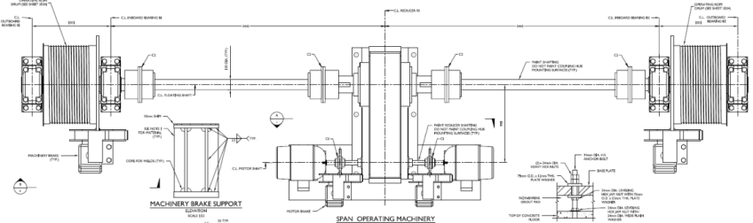
Principal Machinery Components
REAR SUPPORT BOGIES
FRONT ROLLER SUPPORT
RISING GATE
OPERATING MACHINERY
DEFLECTOR SHEAVES
NOSE PINS
SPAN LOCK

Slide 27
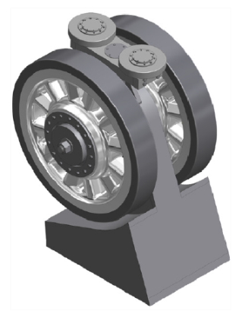
Principal Machinery Components
REAR SUPPORT BOGIES
FRONT ROLLER SUPPORT
RISING GATE
OPERATING MACHINERY
DEFLECTOR SHEAVES
NOSE PINS
SPAN LOCK

Slide 28
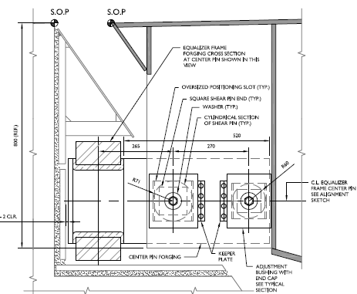
Principal Machinery Components
REAR SUPPORT BOGIES
FRONT ROLLER
RISING GATE
OPERATING MACHINERY
DEFLECTOR SHEAVES
NOSE PINS
SPAN LOCK

Slide 29
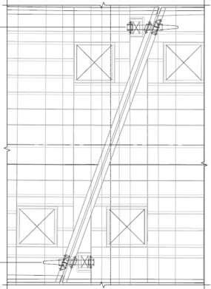
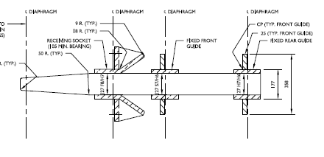
Principal Machinery Components
REAR SUPPORT BOGIES
FRONT ROLLER
RISING GATE
OPERATING MACHINERY
DEFLECTOR SHEAVES
NOSE PINS
SPAN LOCK

Slide 30
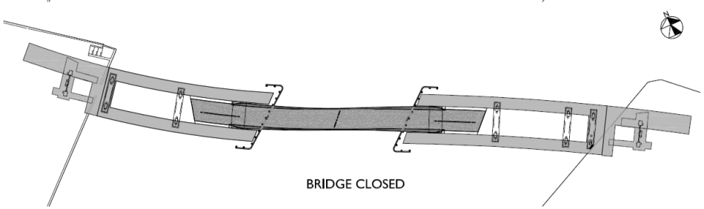
Segregated pedestrians and cyclists
Cycles
Transition Zone
Cycles
Pedestrians
Pedestrians

Slide 31
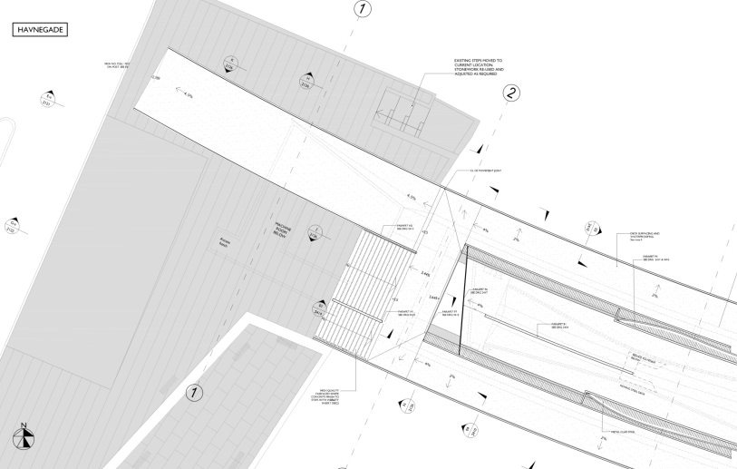
West abutment
Cycles
Pedestrians

Slide 32
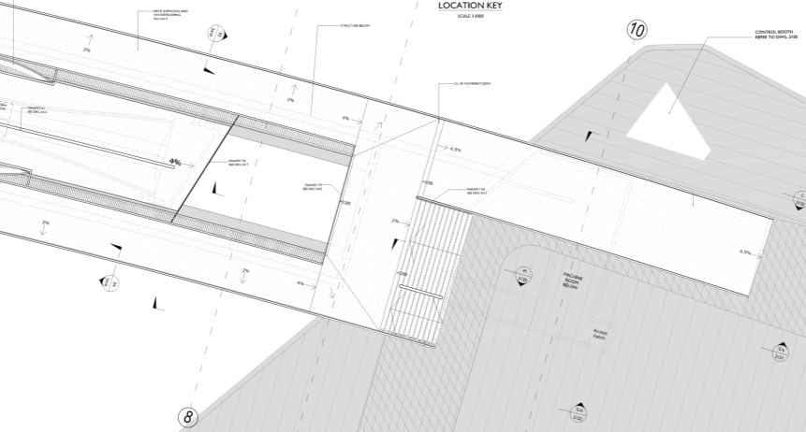
East abutment
Cycles
Pedestrians

Slide 33
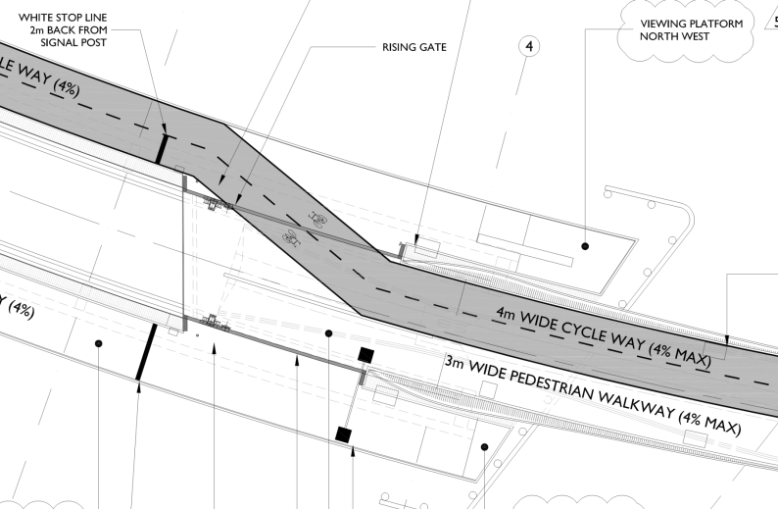
Transition Zone

Slide 34
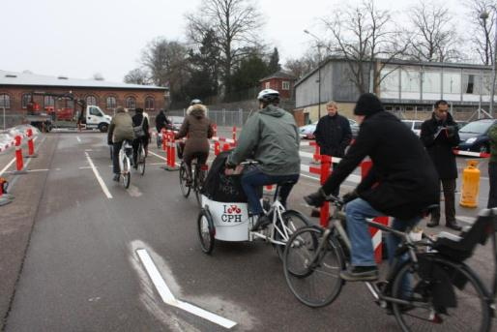
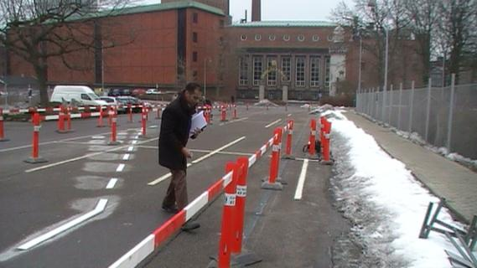
Cycling Test for Transition Geometry
Cycle Test at Carlsberg Factory March 2010

Slide 35
Fixed concrete spans

Slide 36
Fixed concrete spans – key features
Reinforced concrete, no pre-stressing
Curved alignment: S-shape on plan
Permanent formwork for top slab (cast last)
Deck boxes contain drive cables and sheaves
Pre-cambered geometry allows for added weight of steel
Particular need to control construction tolerances because of steel spans resting between.

Slide 37
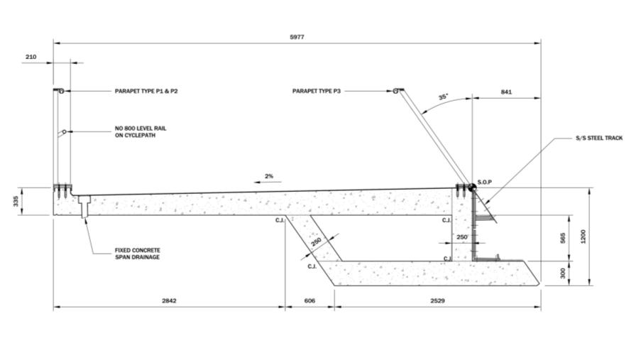
Typical Section Through Concrete Box

Slide 38
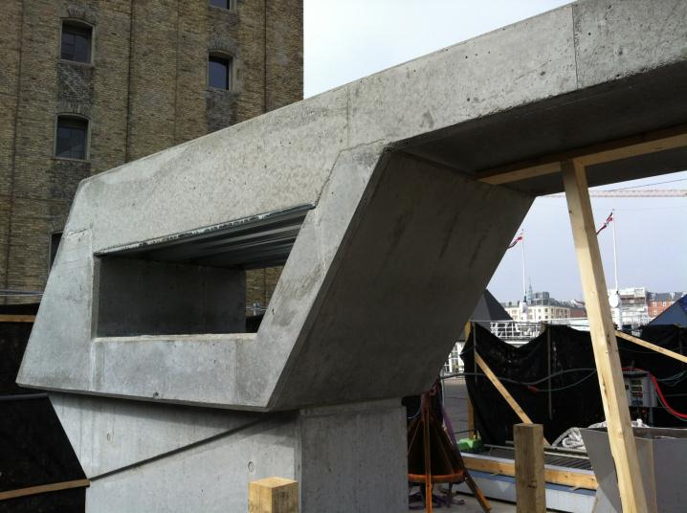
Concrete sample panel

Slide 39
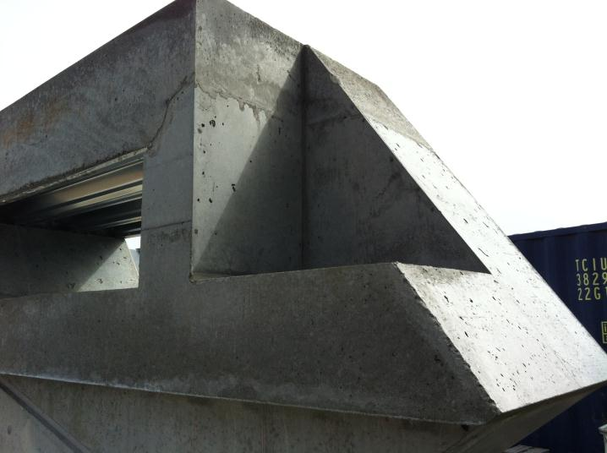
Concrete sample panel

Slide 40
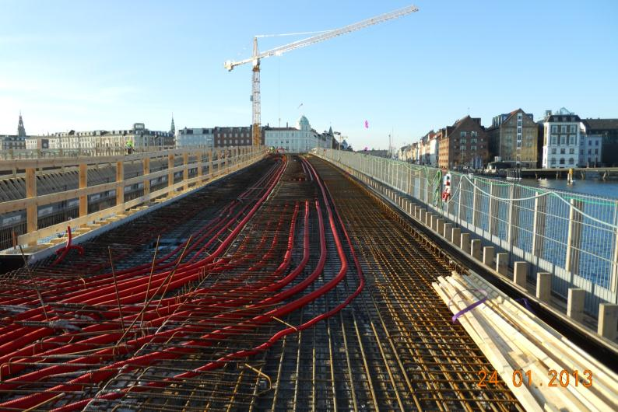
Concrete bridge construction

Slide 41
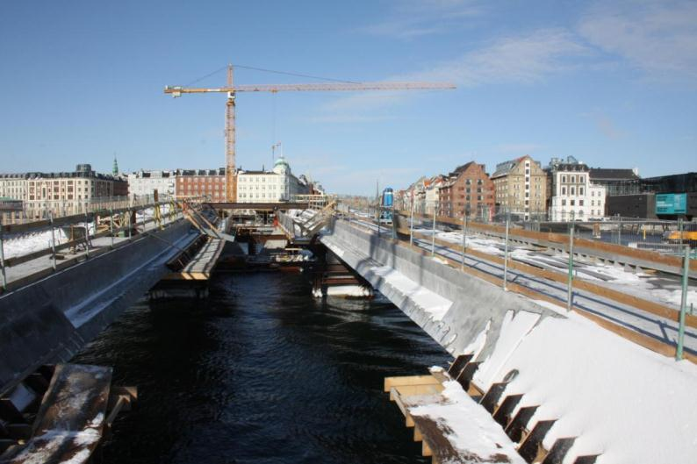
Concrete bridge construction

Slide 42
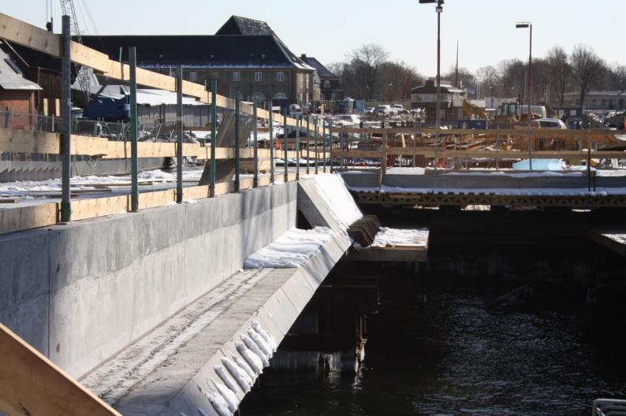
Concrete bridge construction

Slide 43
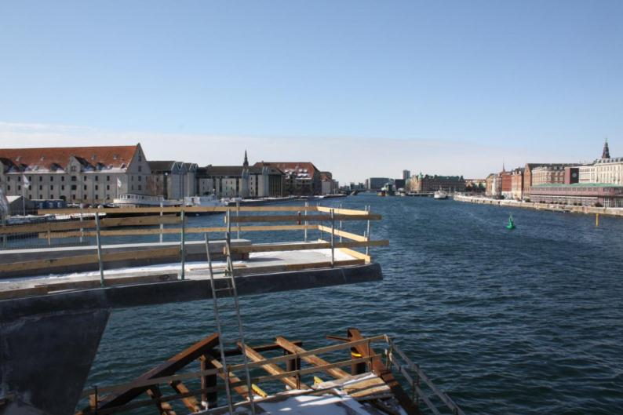
Concrete bridge construction

Slide 44
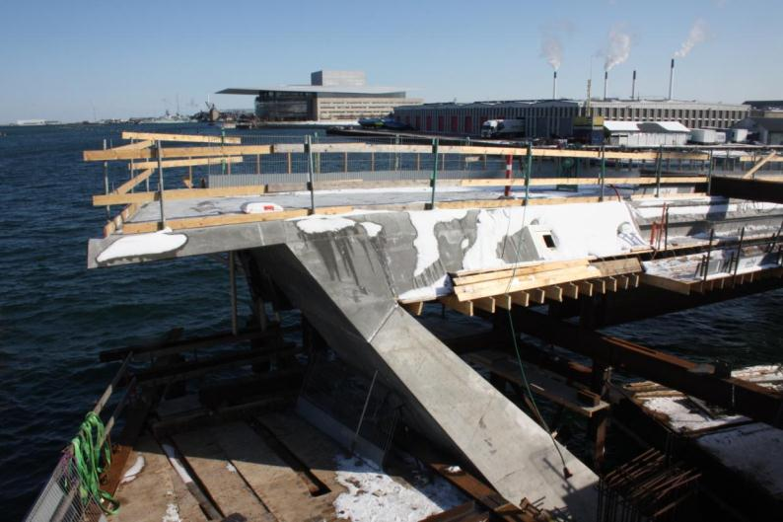
Concrete bridge construction

Slide 45
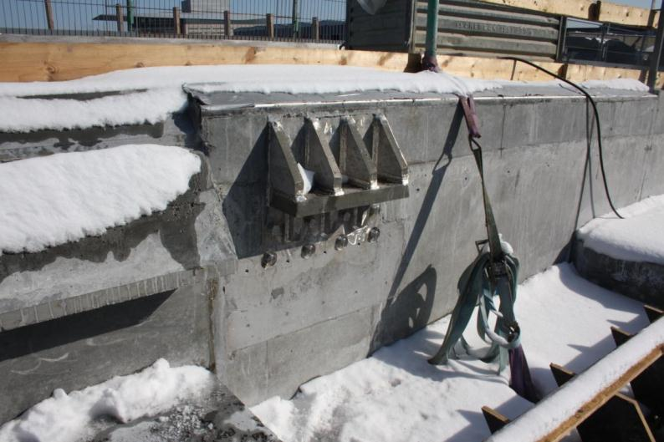
Concrete bridge construction

Slide 46
Moving steel spans

Slide 47
Moving steel girders – key features
Fabricated steel box with complex geometry
Curved on plan and elevation
Constantly varying cross section
Inner web faceted triangular plates
Internal tuned mass dampers
Painted exterior; dehumidified interior

Slide 48
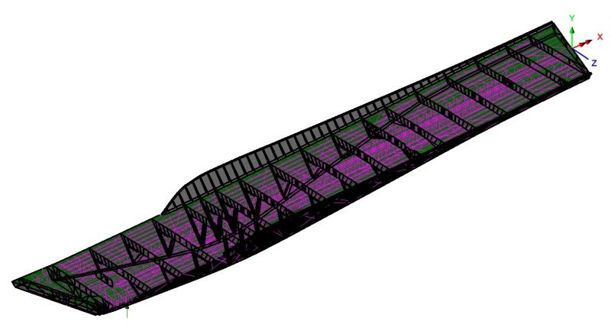
Steel girder, principal structural elements
Upstand
Bottom Chord
Diaphragm/Ring Frame
Track
4 Inclined Webs

Slide 49
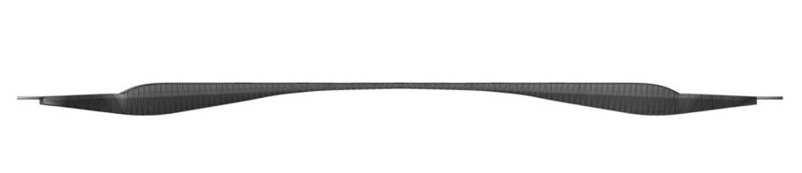
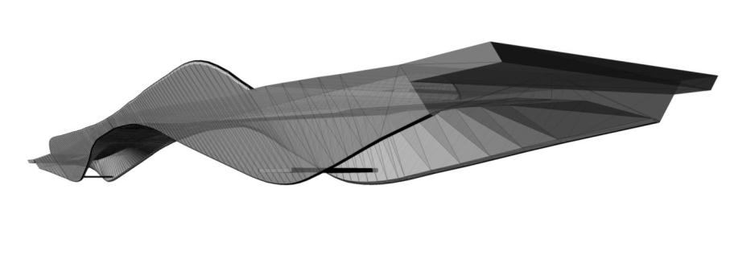
3-D model of steel spans
Elevation
Isometric

Slide 50
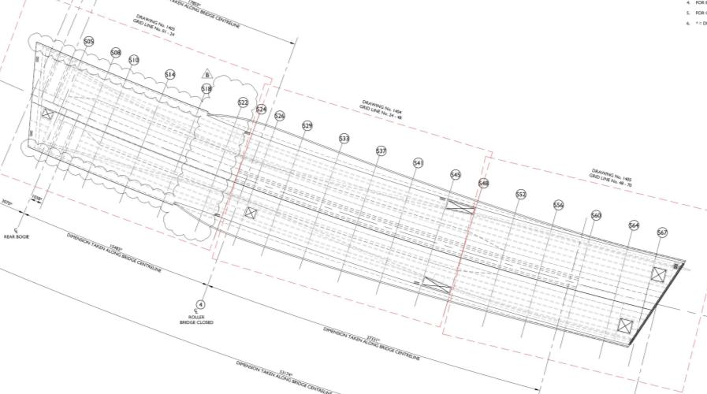
Plan on west steel span

Slide 51
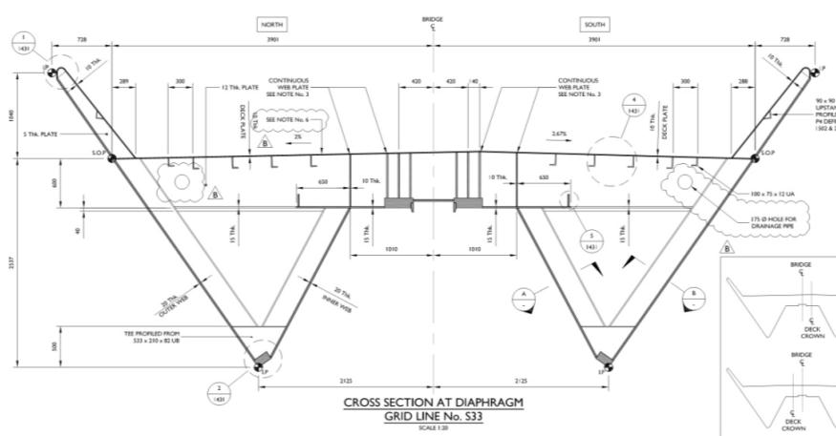
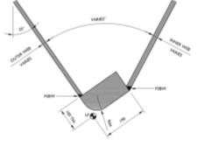
Steel girder typical section
Inner webs
Outer web
Outer web
Bottom chord

Slide 52
Steel girder typical section

Slide 53


Front Roller Support

Slide 54

Section at front roller support position

Slide 55

Plan section at front roller platform
Inspection platform
STRUT
towards abutment
towards midspan
Centre of front roller support

Slide 56

Steel girder typical sections

Slide 57

Steel girder typical sections

Slide 58

Steel girder typical sections

Slide 59

Steel girder typical sections

Slide 60

Steel girder typical sections

Slide 61

Steel girder typical sections

Slide 62

Steel girder typical sections

Slide 63





Inner webs of steel girder
Structural faceted web formed from folded panels

Slide 64

Steel fabrication, March 2013

Slide 65

Steel fabrication, March 2013

Slide 66

Steel fabrication, March 2013

Slide 67

Steel fabrication, March 2013

Slide 68

Steel fabrication, March 2013

Slide 69
Parapets

Slide 70

Havnegade approach

Slide 71


Parapets

Slide 72


Parapets etc.

Slide 73

Parapets fabrication, March 2013

Slide 74

Parapets fabrication, March 2013

Slide 75

Model at Danish Architecture Centre

Slide 76
Progress March 2013

Slide 77

Progress on site, March 2013

Slide 78

Progress on site, March 2013

Slide 79

Progress on site, March 2013

Slide 80

Progress on site, March 2013

Slide 81

Progress on site, March 2013

Slide 82

Progress of steel fabrication, March 2013

Slide 83

Thank you

